Slide 1
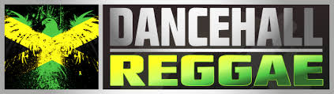
Dancehall
(Reggae)
Spencer Rosenvall
Jemima Singoma

Slide 2
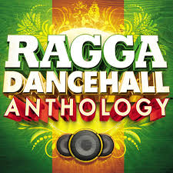
About Dancehall
General things about DanceHall
goes by ‘Ragga’ or Reggae-style dance
Performed by men, women, couples, groups and solo
The most famous dancehall dancers are men
No specific dances, just a style often used in the club
Individual emphasis style of dancing
Dancehall is about attitude and energy
Most dancehall moves were created during Jamaican street party
Many Hip-hop dance moves are actually from Dancehall
Dance hall has many sexual and sensual characteristics

Slide 3
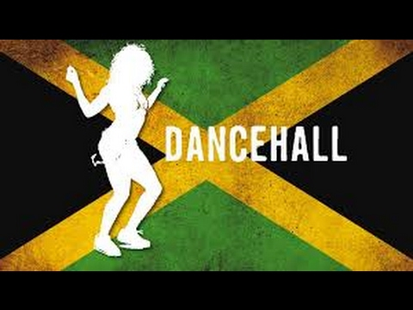
Setting
Where does it happen?
Dance parties
Clubs
Celebrations
Vacation Resorts
How about when??
Mostly at night due to the locations Dancehall is usually danced
Can be danced ANYTIME!

Slide 4
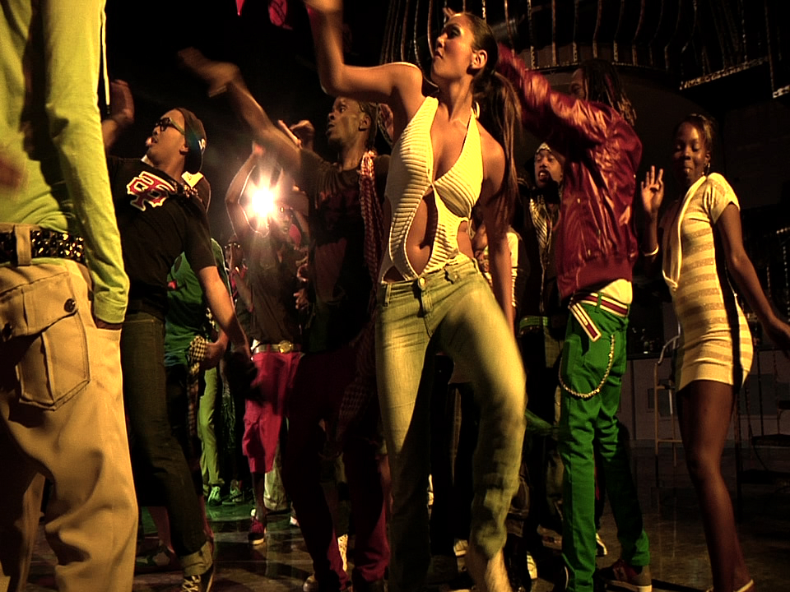
Clothing and Body
In Dancehall there is not much clothing worn usually the girls would just dress casually to either something comfortable to dance in like short jeans, short skirts, long pants over the bottom shirts. While the guys would just wear regular pants and t-shirt. There isn't any body decoration either.
Some people might sing to the song the DJ is playing if it their jams. If not you just dance.
•Describe the dance space.
ØWhat are their traditional dance spaces? Their dance space is in the halls, or circle and they just start dancing either with someone or by yourself.
•Describe the clothing worn
Øthe make-up, no makeup.
Øbody decoration, No decoration.
Øprops (i.e. objects carried or used, etc).
•Do people sing or chant as part of the accompaniment?

Slide 5
Music and Rhythm
By the early 2000s, dancehall inspired pop music saw increased popularity in Jamaica, as well as in the United States and international markets. This was first seen with artists such as Sean Paul, whose single "Get Busy" (2003) became the first dancehall single to reach number one on the US Billboard Hot 100.
Unlike traditional dancehall songs, "dancehall-pop" music is characterized by using material which is common in mainstream pop music, such as repeated choruses, melodic tunes, and hooks, as well as cleaner lyrics featuring less sexual content and profanity.
Central to dancehall is the deejay, who raps, or “toasts,” over a pre recorded rhythm track (bass guitar and drums), or “dub.” ... The rise of deejay Yellowman in the early 1980s marked the transition from mainstream reggae to dancehall music that took place in Jamaican nightclubs.
https://www.youtube.com/watch?v=2OmSAJ1i7LA

Slide 6
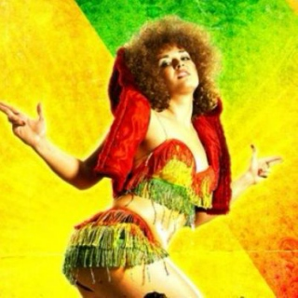
Dance Movement
•What is the meaning of the movement to this group?
in the late 1940s among people from the inner city of Kingston, who were not able to participate in dances uptown. Social and political changes in late-1970s Jamaica, including the change from the socialist government of Michael Manley to Edward Seaga (Jamaica Labour Party),were reflected in the shift away from the more internationally oriented roots reggae towards a style geared more towards local consumption and in tune with the music that Jamaicans had experienced when sound systems performed live.
•What values, cultural norms or ideals are expressed?
The value of this dance was to get to together and celebrate the feeling of having a place where you belong and just letting everything out on the dance floor. Forgetting about your problems.
https://www.youtube.com/watch?v=AM_xGJV7EwA

Slide 7
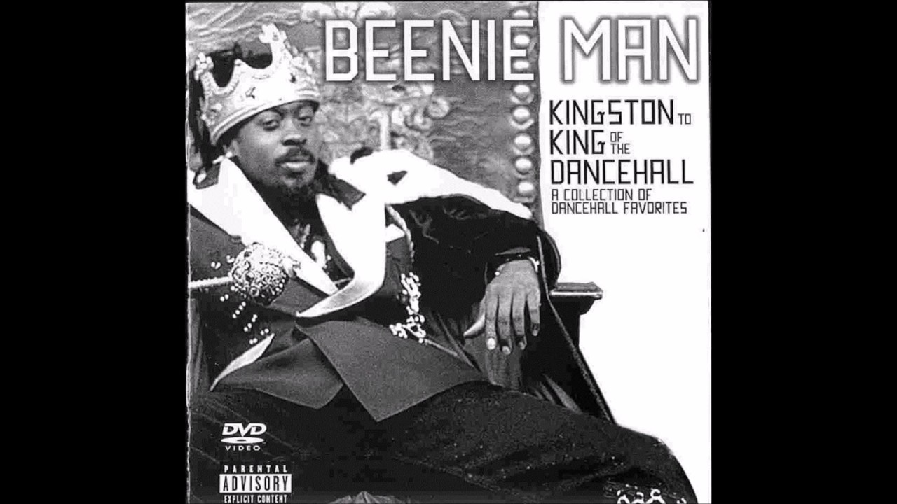
History
“Dancehall is named after Jamaican dance halls in which popular Jamaican recordings were played by local sound systems. They began in the late 1940s among people from the inner city of Kingston, who were not able to participate in dances uptown. Social and political changes in late-1970s Jamaica, including the change from the socialist government of Michael Manley (People's National Party) to Edward Seaga (Jamaica Labour Party), were reflected in the shift away from the more internationally oriented roots reggae towards a style geared more towards local consumption and in tune with the music that Jamaicans had experienced when sound systems performed live. Themes of social injustice, repatriation and the Rastafari movement were overtaken by lyrics about dancing, violence and sexuality”

Slide 8
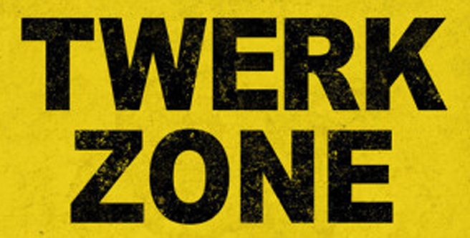
Historical Oppression in the USA
Identify discrimination, stereotypes, bigotry, even legislation that has suppressed this group
An example of this is twerking. Lots of people use twerking in clubs as almost a mating ritual, but governed by the working-class. Higher class people oftentimes think of it as demonic and low-class. It is not just twerking, but other dance moves as well.
How has this influenced the evolution of their dance and cultural celebrations in this country?
Movements from the Reggae-style dancing are all across the USA, mainly seen in clubs, however.
In what ways have this group contributed to American culture as we know it?
The USA has adopted it and accepted it as a night-life form of dance often used to find potential partners to dance with.

Slide 9
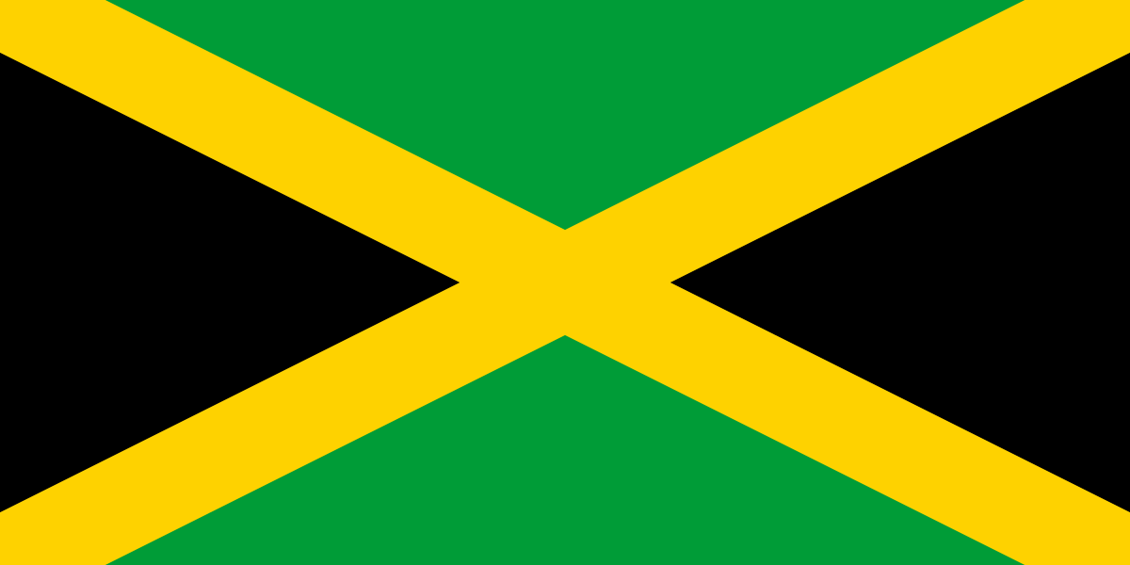
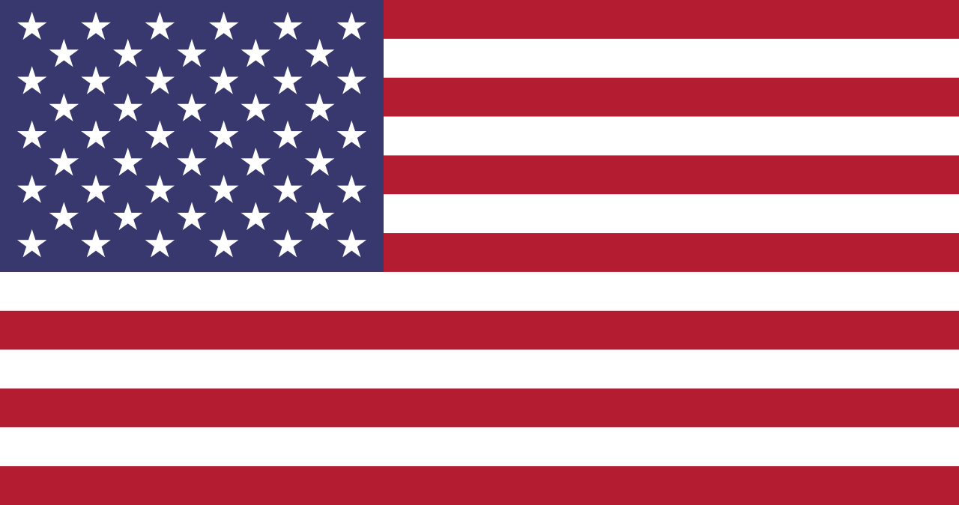
More Historical Analysis
How have their traditions and dance evolved or changed as the group has acculturated?
Not much has changed with the dance and traditions there of. Many aspects were adopted into hip hop, but this unique style has thrived along the years.
Has the dominant/privileged class acculturated the dance of this group?
The history itself shows that this dance was created by the lower class because they weren’t privileged enough to participate in upper-class dances and celebrations.

Slide 10
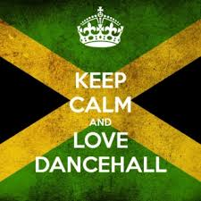
Oppression still happen Today?
•Are there social, economic, or political structures still in place today that suppress this group and, therefore, devalue their cultural expression?
Dancehall is expanding in many ways that so many music artist are using the dance style and music to their videos today. In many african/Jamaican clubs have dancehall and plays the music, while you're there you wouldn't see many Americans in those clubs. Probably because it is not their type of dance or they just devalue the cultural expression.

Slide 11
Conclusion
What have you learned to appreciate about the group? How are we similar? What are our commonalities as contemporary peoples?
We have learned to appreciate and use what we have either space or a thing and turn it into something more. These people in jamaica were not invited to upstate dances parties, that didn't matter they had halls and Dj and they decided to use the space that they had to create something meaningful.
We think our commonalities would be on music but not the dance because most people consider the way the people danced too sexual. It doesn't have to be if you're doing your own dance moves and not worry about how the other person is dancing with their partners or by themselves.

Slide 12
Resources
https://en.wikipedia.org/wiki/Jamaican_Americans#Dances_and_songs
https://en.wikipedia.org/wiki/Dancehall
https://www.datehookup.com/thread-1457462.htm
https://www.huffingtonpost.com/jessica-joseph/goodbye-twerking-and-good_b_3850348.html
https://whisper.sh/whisper/0510ce417732531913797cfffba42f4d7bc6cf/Twerking-is-incredibly-low-class-You-should-feel-bad-about-yourself
http://jamaicansmusic.com/learn/origins/dancehall

